Slide 1
Sysops Squad Redesign and Migration
The Mad Katas
May 2021

Slide 2
Not only is a solution needed, the solution needs to be enacted quickly to save this arm of the Penultimate Electronics business.

Slide 3
Problems
With the current Sysops Squad system

Slide 4




The person who showed up couldn’t fix my printer!
I stayed in all day and no one showed up!
My laptop won’t turn on, and when I called your operator said they the ticket system was down!
I needed help with my electric hob but the website wouldn’t load!

Slide 5



I knew I had a job to go to, but the ticket information wouldn’t load!
The system keeps freezing up and when we make changes something else breaks!
It was so embarrassing having to say I couldn’t fix their problem!

Slide 6

We are throwing money down the drain!
Customers will be cancelling their contracts and going elsewhere.
The brand image is being tarnished.

Slide 7
Tickets are a problem.

Slide 8
Updated Ticket Scenarios
The workflows for tickets in the new Sysops system.

Slide 9
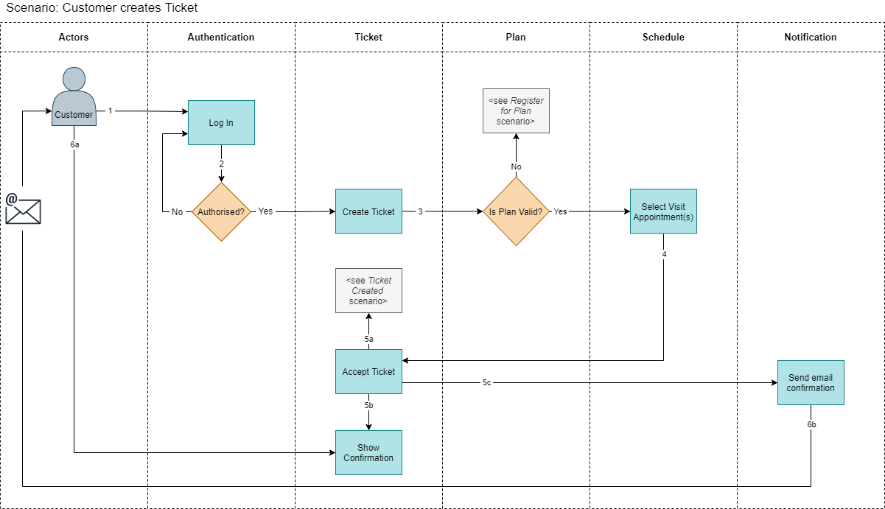
Customer creates a Ticket

Slide 10
Customer creates a Ticket

Slide 11
Customer creates a Ticket

Slide 12
Customer creates a Ticket

Slide 13
Customer creates a Ticket

Slide 14
Customer creates a Ticket

Slide 15
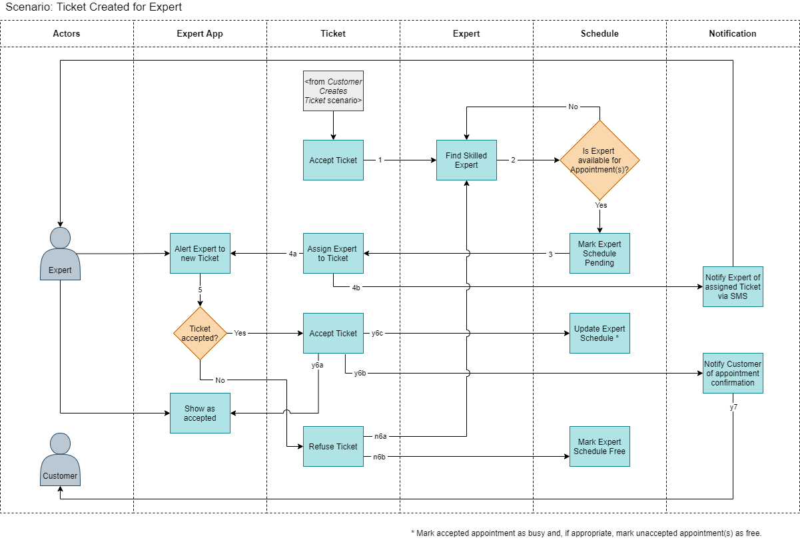
Ticket created for Expert

Slide 16
Ticket created for Expert

Slide 17
Ticket created for Expert

Slide 18
Ticket created for Expert

Slide 19
Ticket created for Expert

Slide 20
Ticket created for Expert

Slide 21
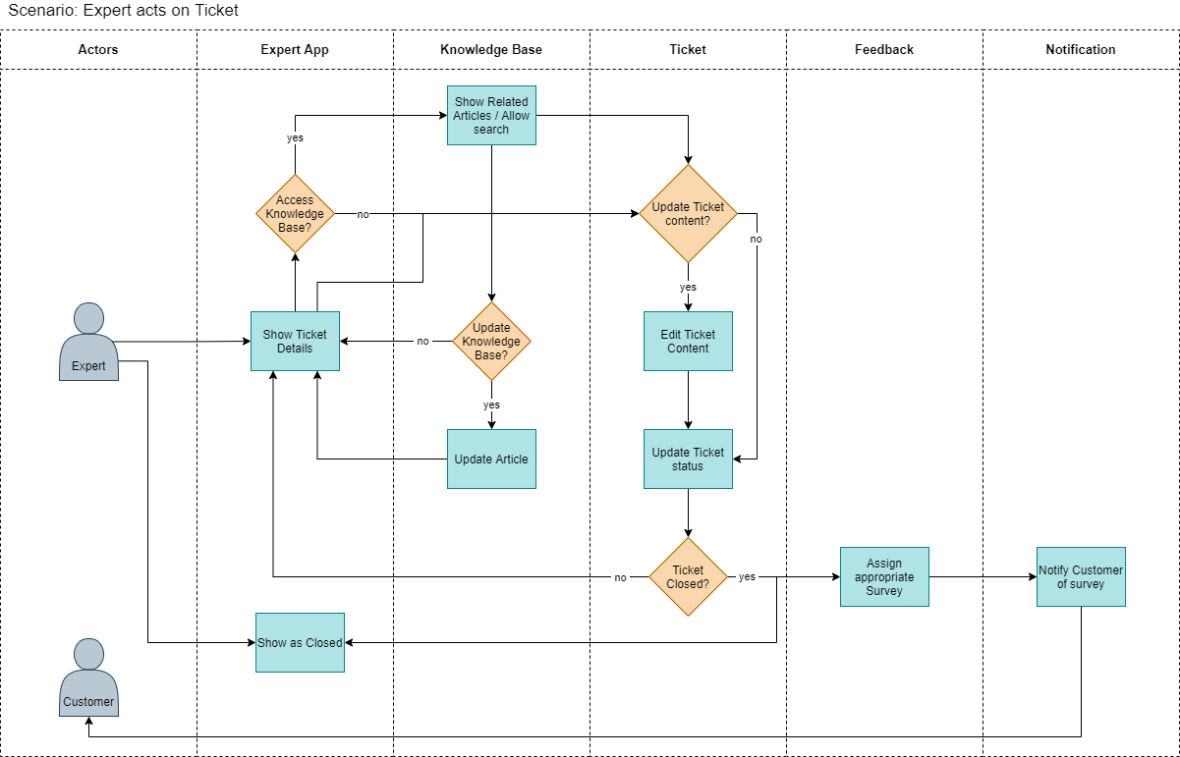
Expert acts on Ticket

Slide 22
Expert acts on Ticket

Slide 23
Expert acts on Ticket

Slide 24
Expert acts on Ticket

Slide 25
Expert acts on Ticket

Slide 26
Key Architecture Characteristics
Characteristic | Source
Reliability | lost tickets ticket assigned to wrong expert (incorrect skills)
Data Integrity | lost tickets ticket assigned to wrong expert (incorrect skills)
Workflow | lost tickets ticket assigned to wrong expert (incorrect skills)
Scalability/Elasticity | system frequently freezes up / crashes thought to be because of a spike in usage
Availability | the system is not always available for web-based and call-based ticket management
Maintainability | change is difficult and risky change take a long time and usually breaks something else
Testability | change is difficult and risky change take a long time and usually breaks something else

Slide 27
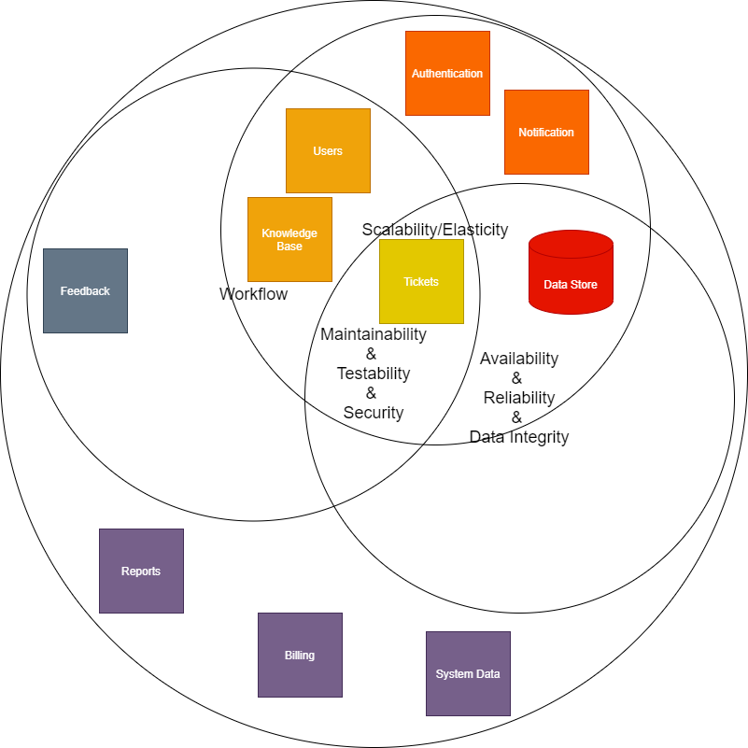
Key Architecture Characteristics

Slide 28
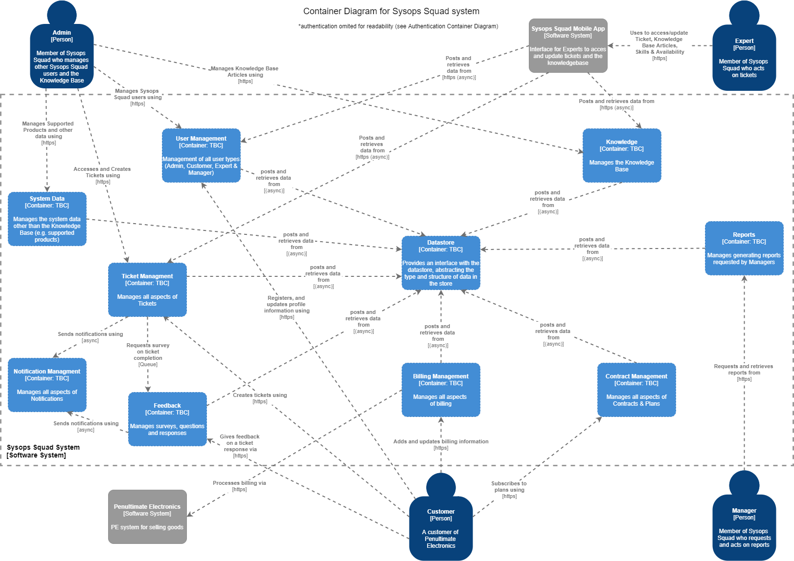
Containers

Slide 29



Data Store Options
Requirement | Relational | Document | Graph
Data must be accurate when reading and writing
Data should be fast to retrieve
Allow data migration from the current data store
Have high availability
Easy to update the schema
Easily maintainable querying
Manage relationships between all the entities

Slide 30
Data Store Options
Requirement | Relational | Document | Graph
Data must be accurate when reading and writing
Data should be fast to retrieve
Allow data migration from the current data store
Have high availability
Easy to update the schema
Easily maintainable querying
Manage relationships between all the entities

Slide 31
Data Store Options
Requirement | Relational | Document | Graph
Data must be accurate when reading and writing
Data should be fast to retrieve
Allow data migration from the current data store
Have high availability
Easy to update the schema
Easily maintainable querying
Manage relationships between all the entities

Slide 32
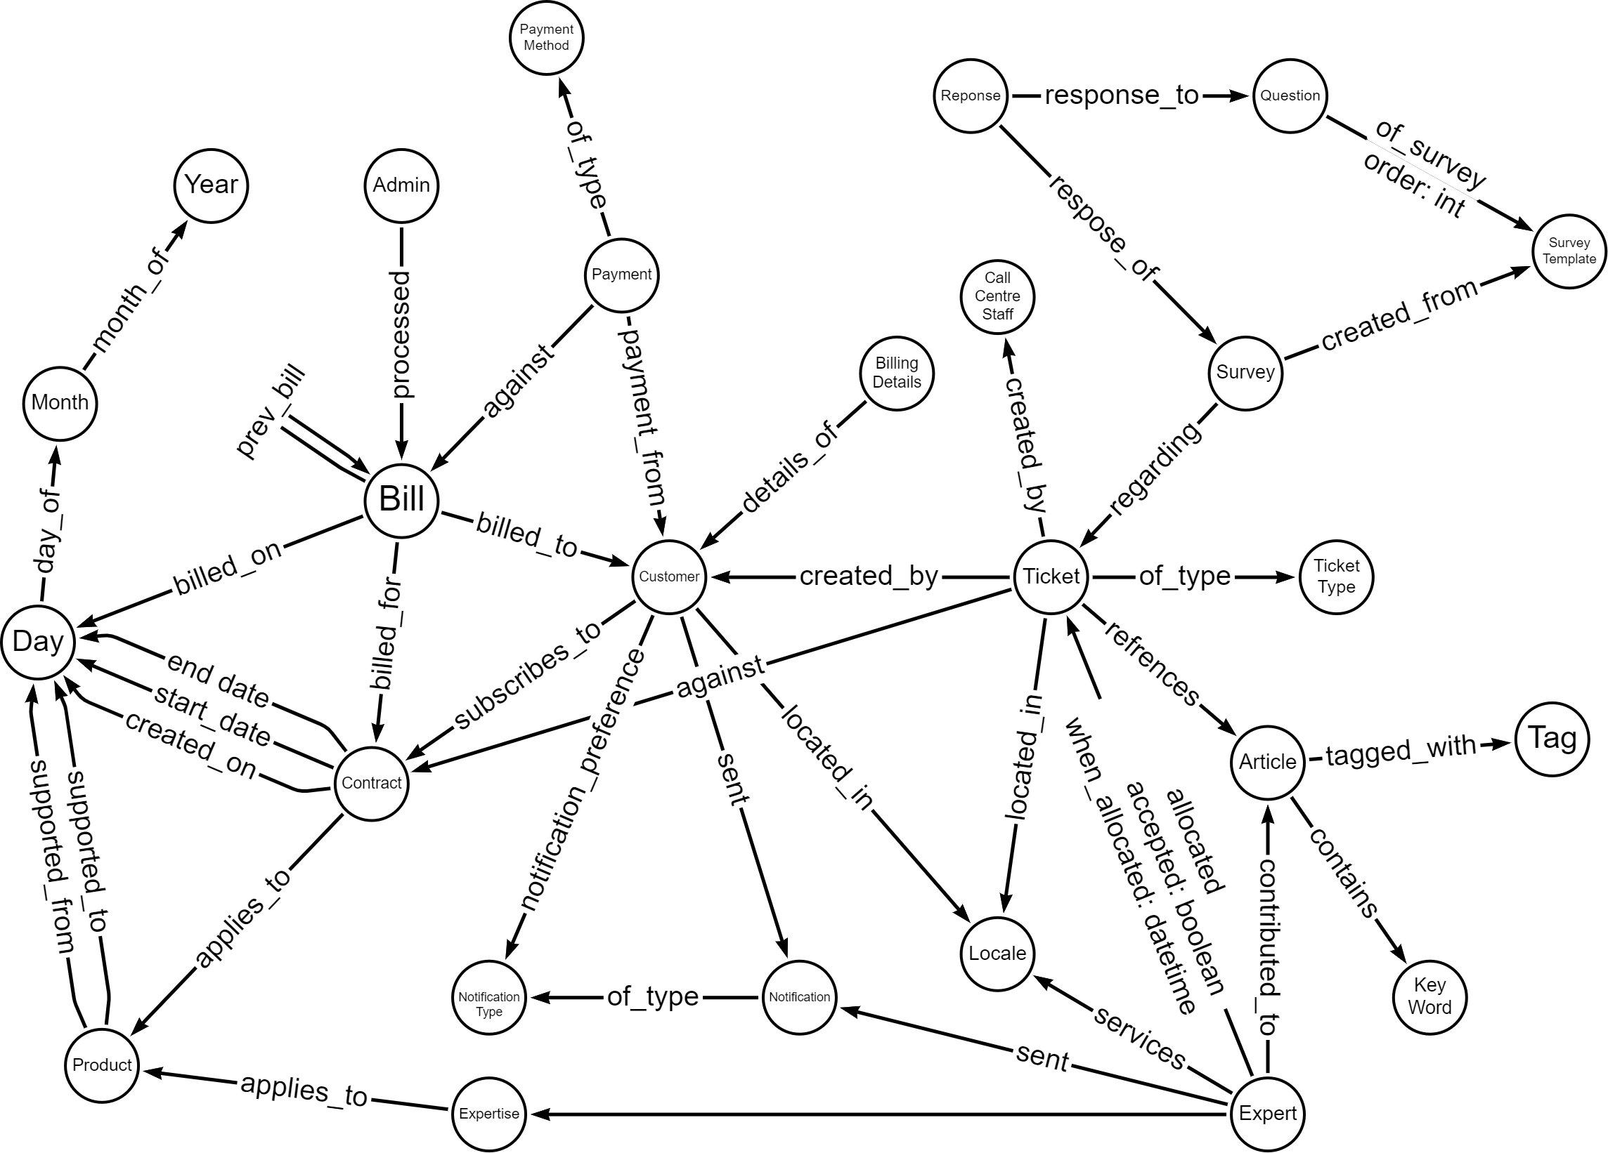
Schema

Slide 33
Tickets are a problem.
Our biggest problem.

Slide 34
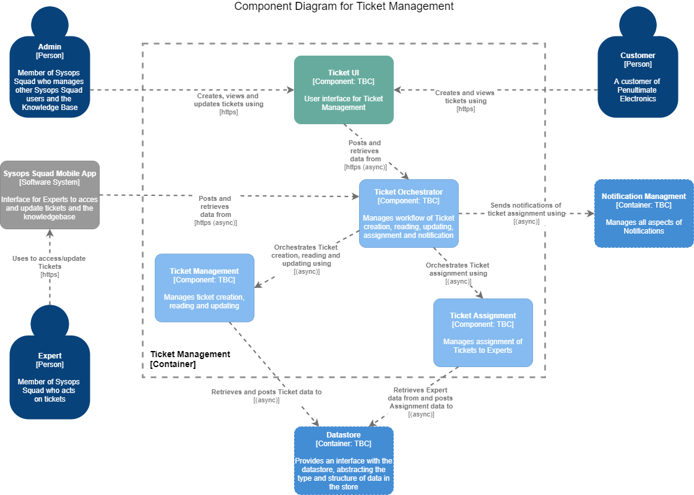
Ticket Domain

Slide 35
Ticket Domain

Slide 36
Ticket Domain

Slide 37
Ticket Domain

Slide 38
Ticket Domain

Slide 39
Ticket Domain

Slide 40
Ticket Domain

Slide 41
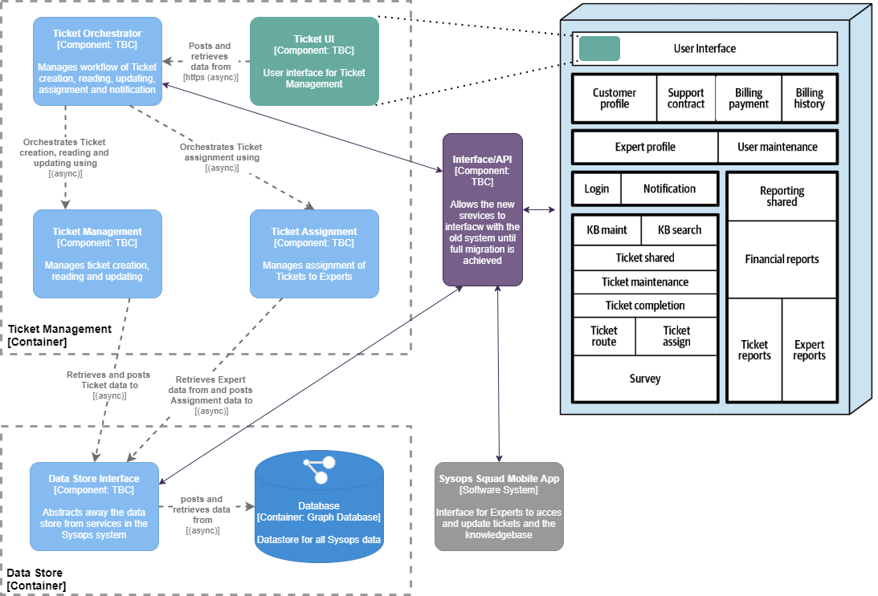
Migration Iteration 1

Slide 42
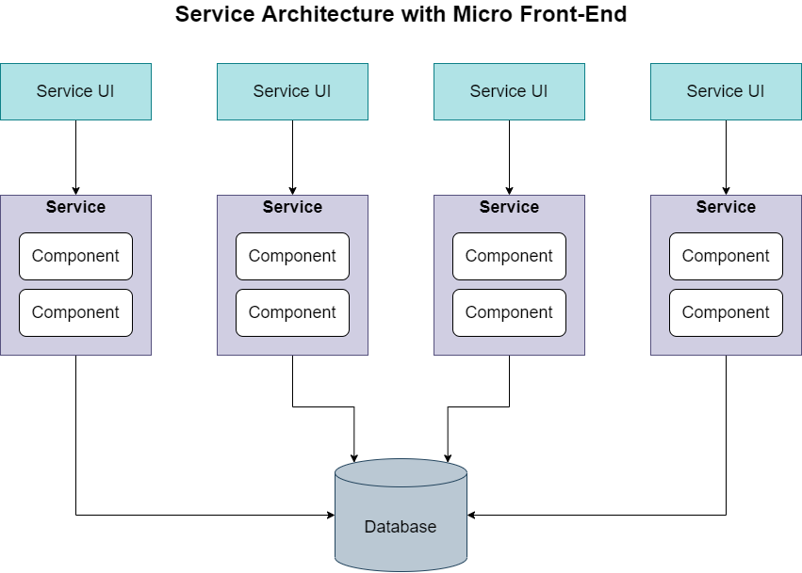
Migration Goal

Slide 43
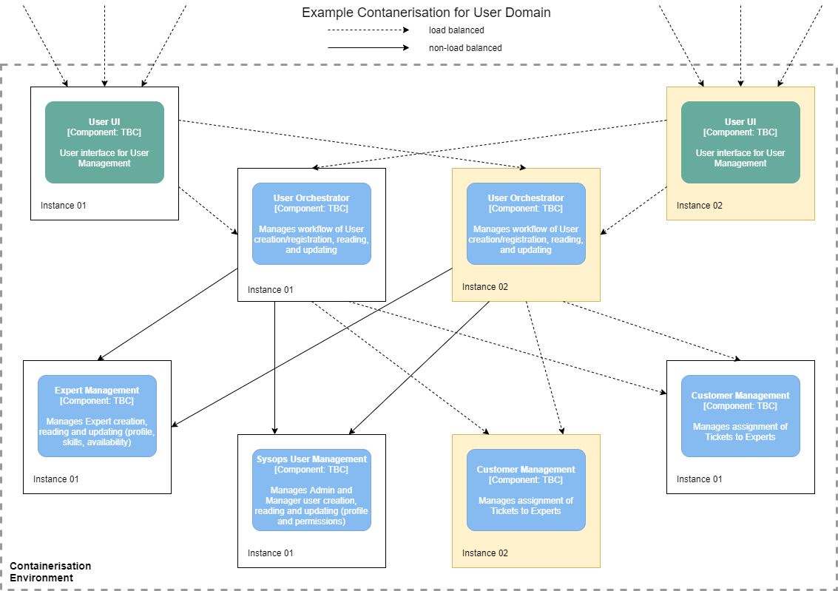
Deployment

Slide 45
Questions?
The Mad Katas
https://github.com/tekiegirl/TheMadKatas/

